Slide 1


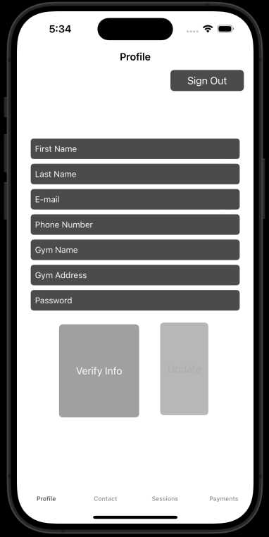
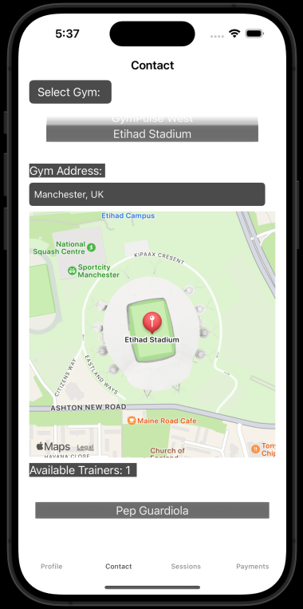
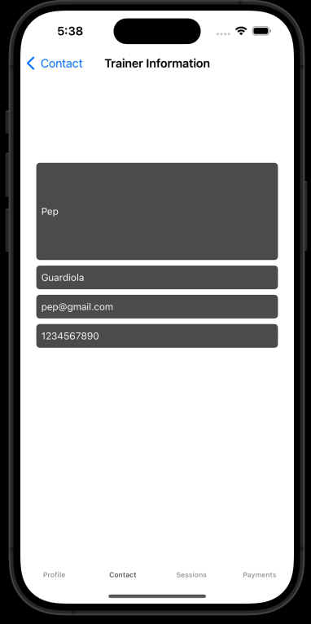
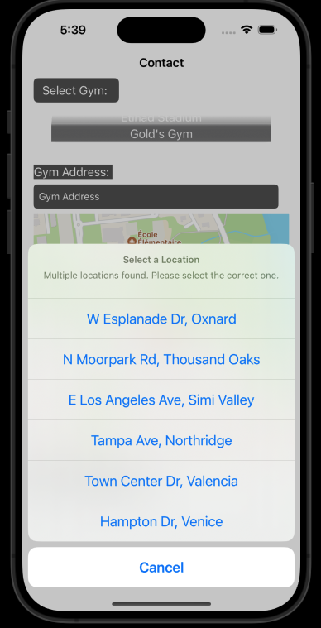
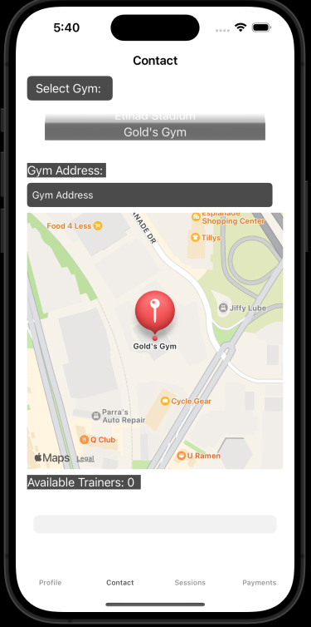
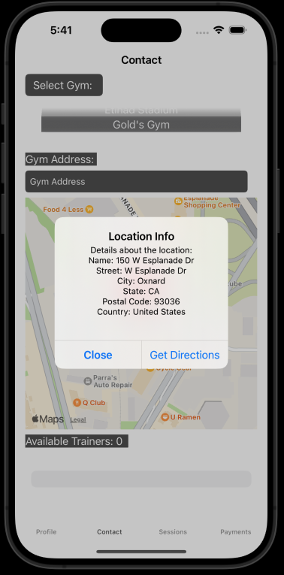
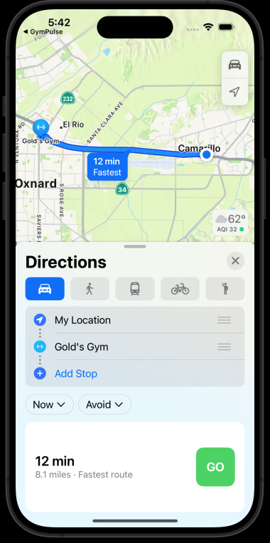
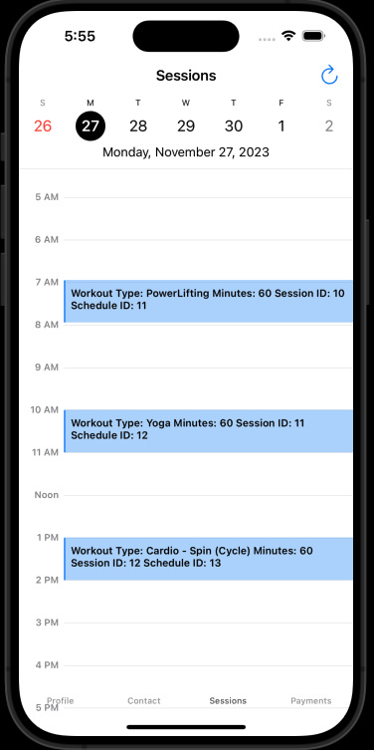
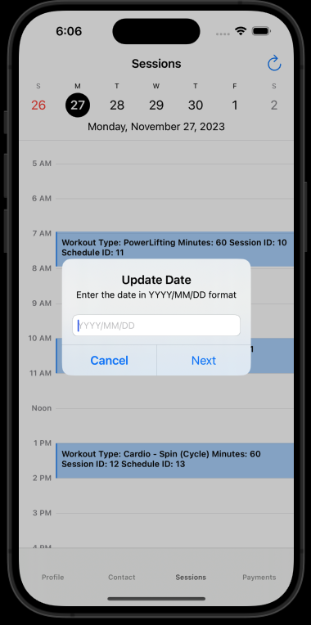
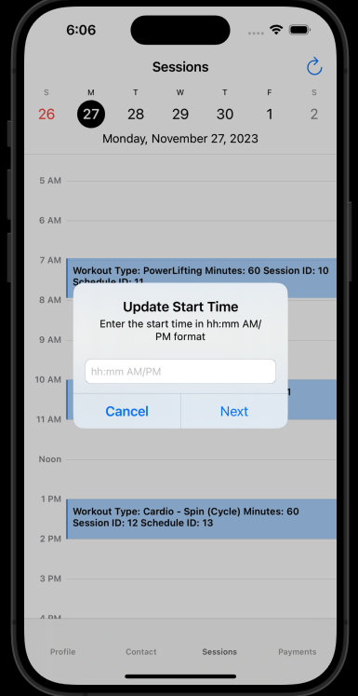
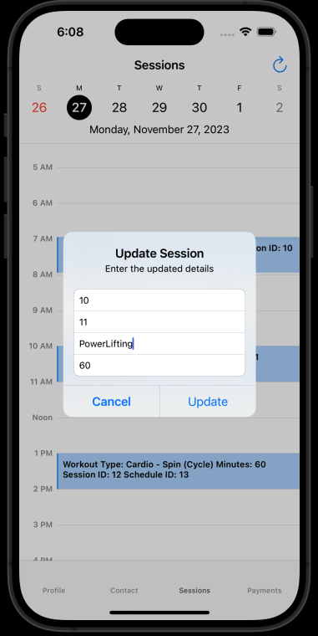
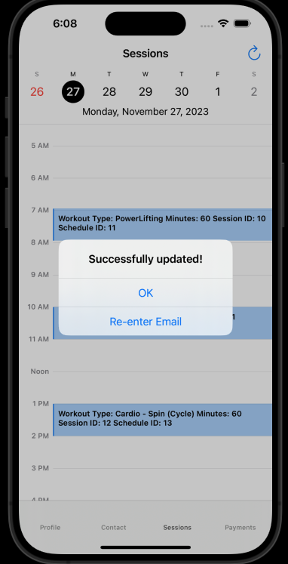
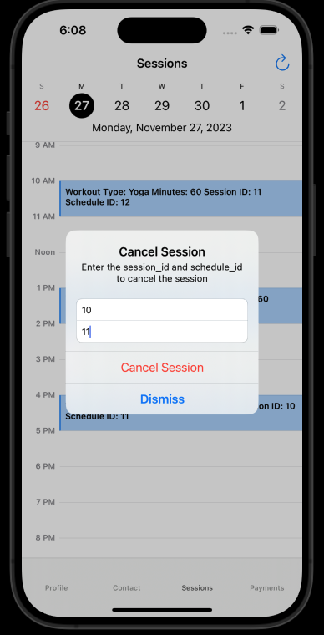
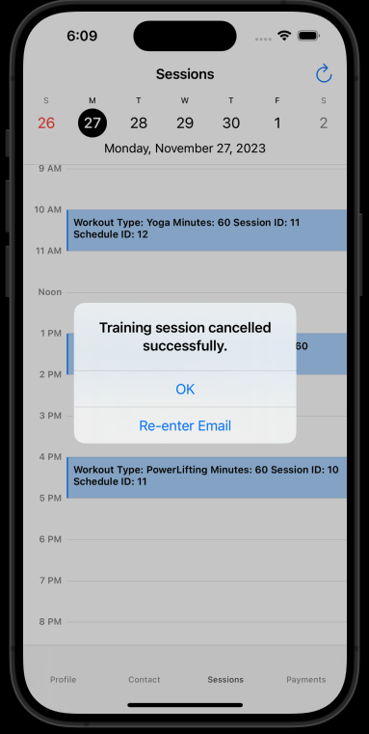
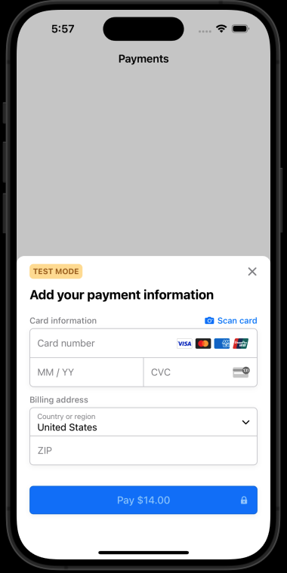
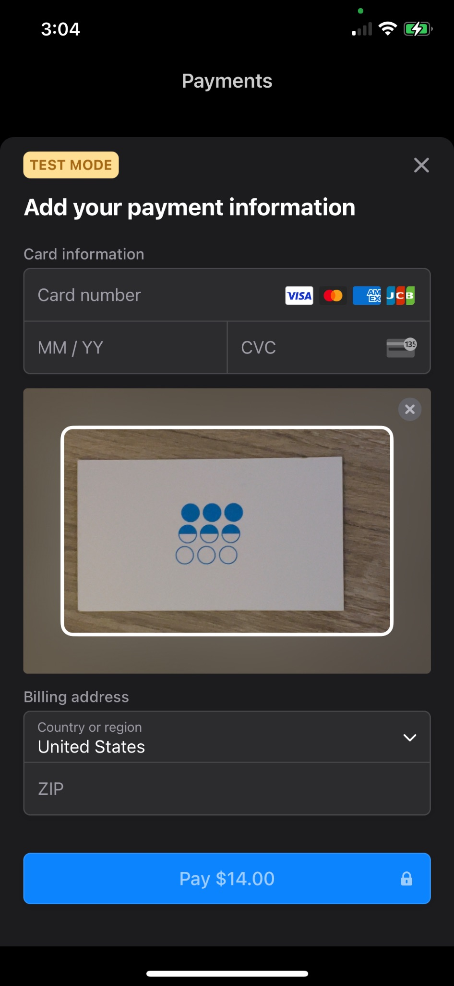



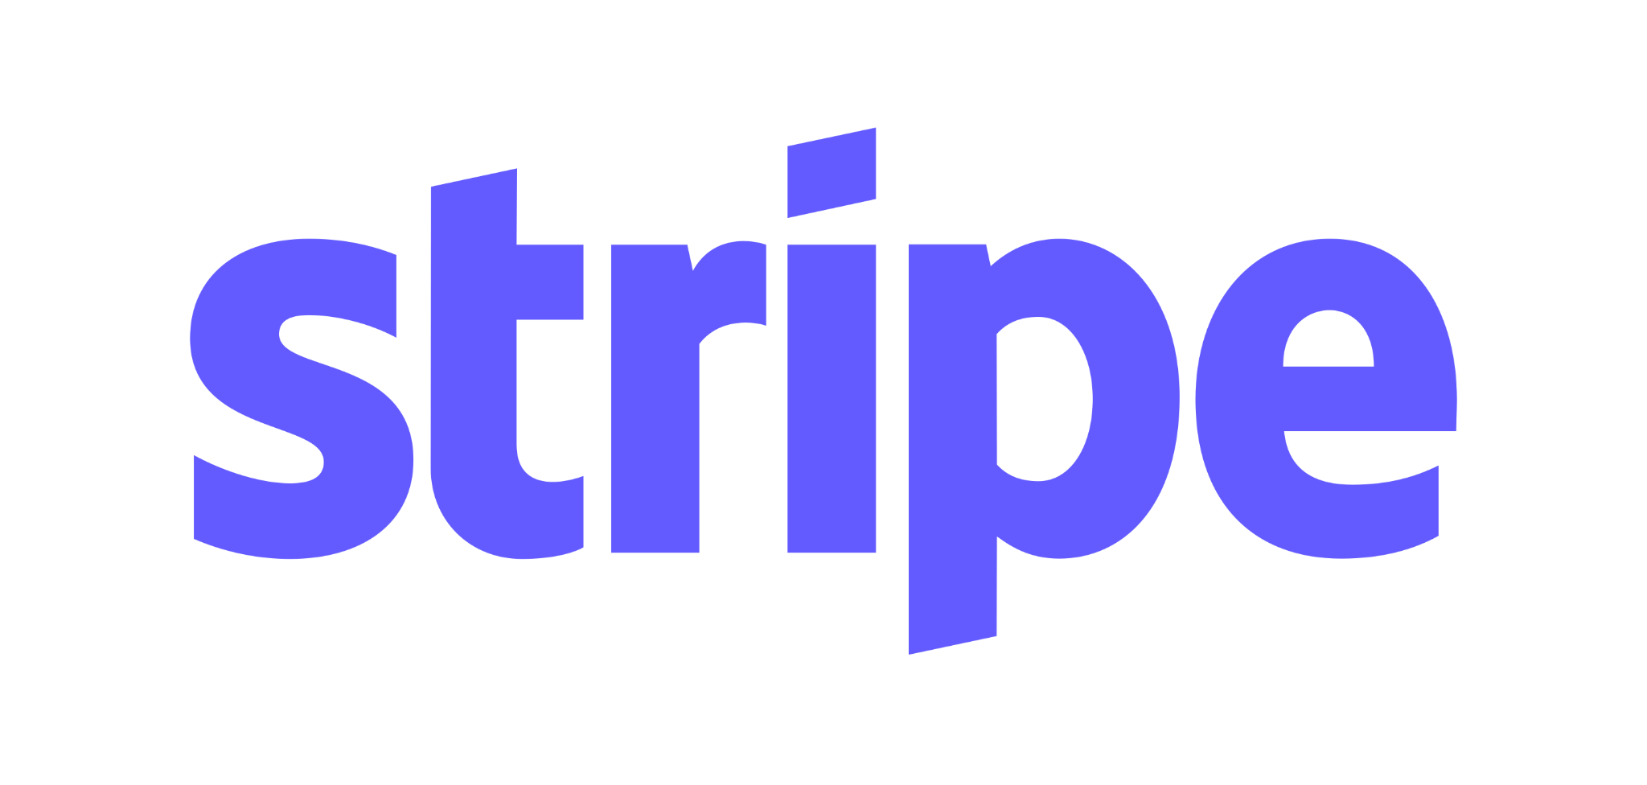
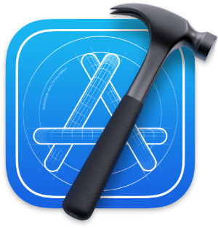


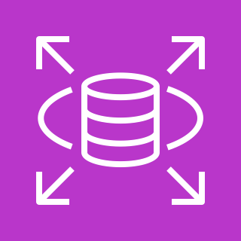

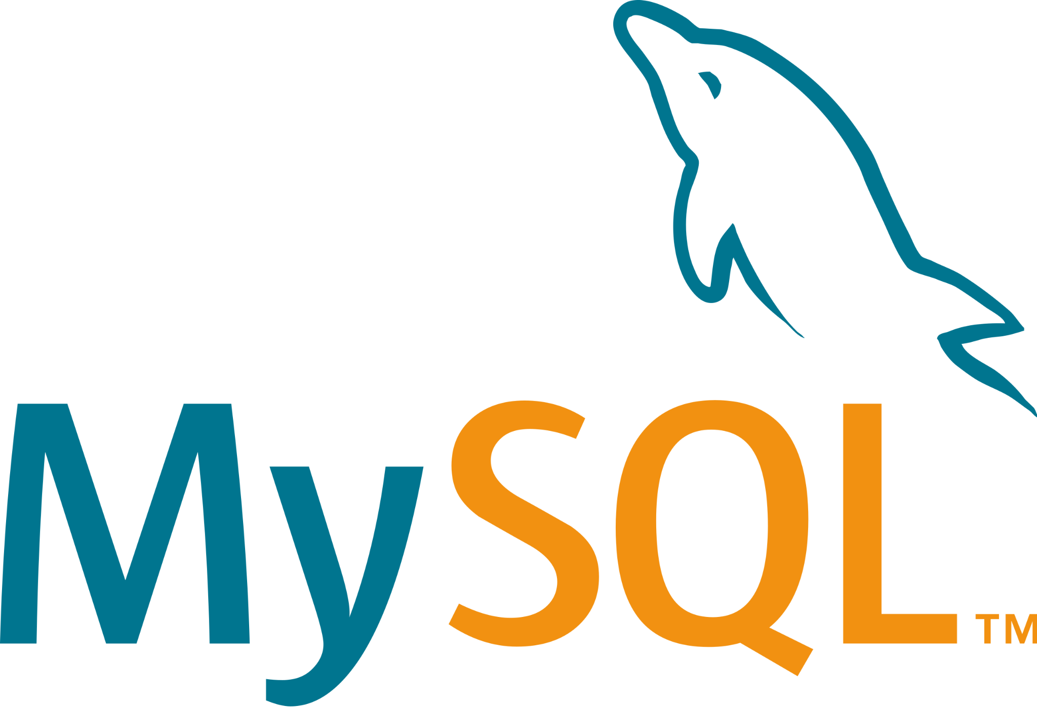

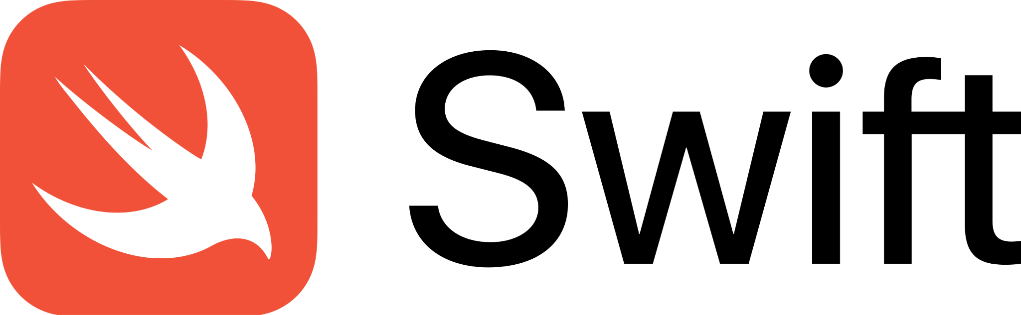


GymPulse iOS App
Axel Mora • Professor: Dr. Brian Thoms • COMP - 499 Sec. 006 - Capstone Project
Introduction
Results
Introducing GymPulse, an innovative iOS app developed with Swift, designed to transform the fitness experience for both trainers and clients. Integrating Amazon AWS and a MySQL database, it offers secure and efficient management of schedules, client interactions, and financial transactions. Trainers benefit from streamlined client management and payment processing with Stripe integration, while clients enjoy the ease of booking and managing sessions. The user-friendly interface, crafted in Swift and UIKit, aligns with Apple's design principles and includes MapKit and Push Notification Service integrations for enhanced functionality. Embark on your fitness journey with GymPulse today and experience the future of personalized fitness management!
Profile Update Screen
Contact Screen
Contact Screen Location-Based Search w/ Apple Maps
Methodology
I initiated the development of GymPulse [18] by setting up a robust backend on an Amazon AWS EC2 instance [1], integrating an Apache web server [2], PHP [3], and MySQL [4]. This step was crucial for ensuring secure, scalable storage and processing capabilities, which are fundamental for managing the complex data and transactions of the app.
I then developed multiple backend API endpoints to handle functions such as user registration, Stripe payment processing [5], and calendar updates. These endpoints were instrumental in enabling smooth interactions between the app’s frontend and backend, ensuring efficient data management.
My focus shifted to frontend development, utilizing Xcode [6], Swift [7], and UIKit [8]. This phase concentrated on implementing user authentication, integrating the Stripe SDK [9] for in-app payments, and designing a user-friendly interface for various functionalities, including scheduling and contact management.
An important enhancement was the integration of CalendarKit [10] [11], which significantly improved the app’s scheduling features. This allowed users to manage training sessions through an interactive calendar interface, closely linked with the GymPulse MySQL database hosted on Amazon AWS RDS [12] [13], ensuring synchronized session management.
Integrating the Stripe iOS Mobile SDK [9] was a major step forward, allowing secure and diverse in-app credit card transactions. I developed a checkout page within the app that could recognize different card types and support international billing, enhancing the app's payment flexibility.
Throughout the development process, I utilized tools like Postman [14] for API testing and MySQL Workbench [15] for database management to ensure the robustness and efficiency of the app. I also meticulously documented and managed the project through Git [16] and GitHub [17] [18], maintaining high standards of code organization and version control.
Interactive Calendar
Payments Screen w/ Stripe
Technologies
References
https://aws.amazon.com/ec2/
https://httpd.apache.org
https://www.php.net
https://www.mysql.com/
https://stripe.com
https://developer.apple.com/xcode/
https://developer.apple.com/swift/
https://developer.apple.com/documentation/uikit
https://stripe.com/docs/libraries/ios
https://github.com/richardtop/CalendarKit
https://swiftpackageregistry.com/richardtop/CalendarKit
https://aws.amazon.com/rds/
https://aws.amazon.com/rds/mysql/
https://www.postman.com
https://www.mysql.com/products/workbench/
https://git-scm.com/
https://github.com
https://github.com/AxelMoraCastanon/GymPulse
Conclusion
In conclusion, GymPulse stands as a revolutionary tool in the realm of fitness and personal training management. By seamlessly integrating essential features like scheduling, client management, and secure payment processing via Stripe, it offers an unmatched experience for both trainers and clients. Its intuitive design and robust backend ensure a user-friendly and reliable platform, enhancing the efficiency and effectiveness of fitness management. Embrace the future of fitness with GymPulse – download it today and elevate your training experience to new heights!

